Slide 1
Relační databáze
Tomáš Holý 4.D

Slide 2
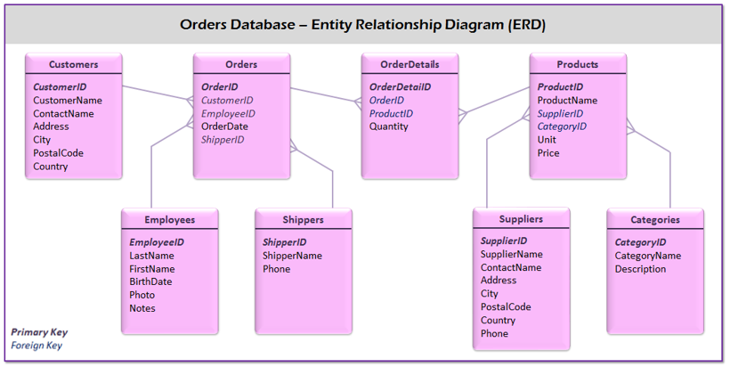
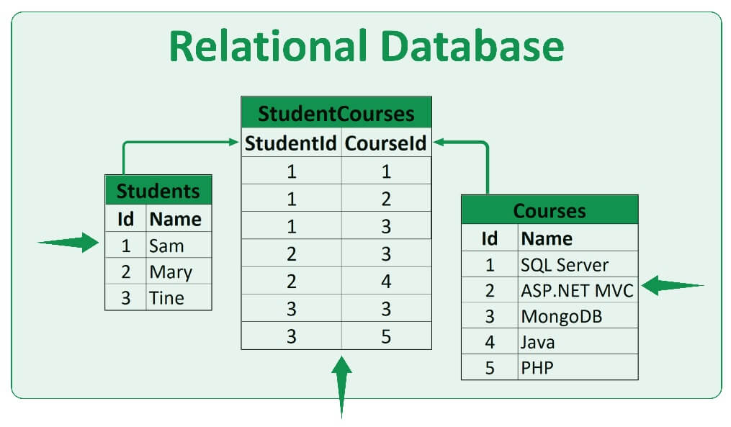
Co to je relační databáze
Je to databáze obsahující relace, která je tvořena samostatnými tabulkami a vazbami mezi nimi

Slide 3
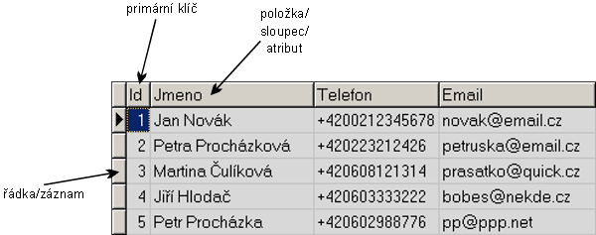
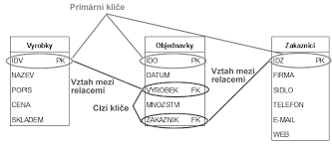
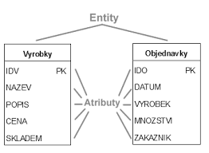
Základní pojmy
Relace
Entita
Atribut
Klíč
Normalizace
Relační model

Slide 4
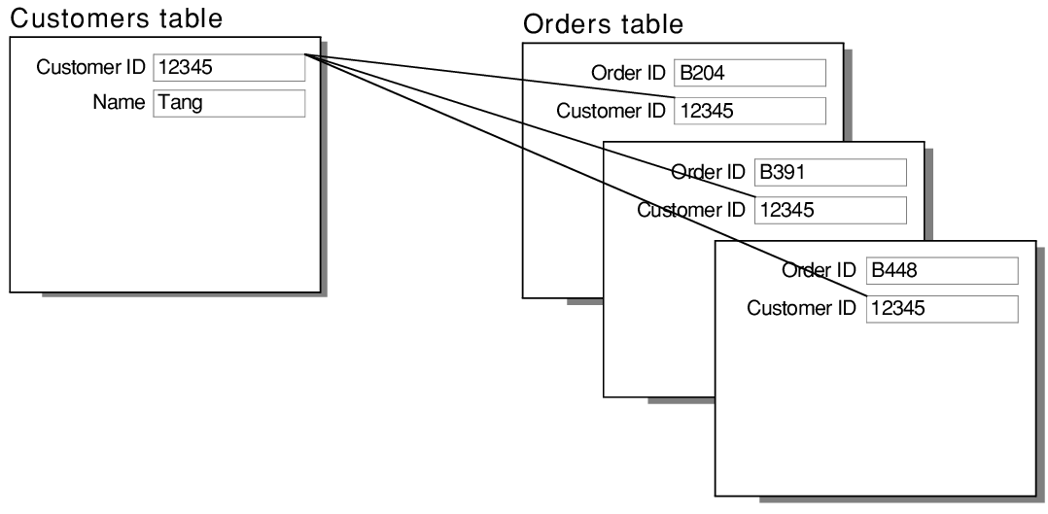
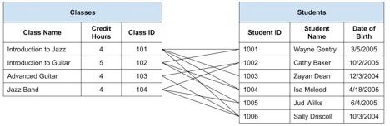
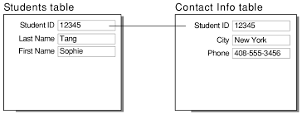
Druhy relací
Rekurzivní relace
One – to – one
One – to many
Many – to – many

Slide 5



Systém řízení databáze
Microsoft SQL server
My SQL (Oracle Corporation)
DB2 (IBM)

Slide 6
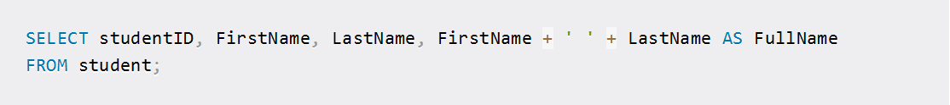
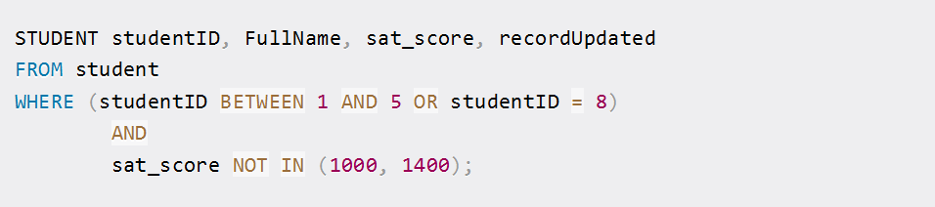
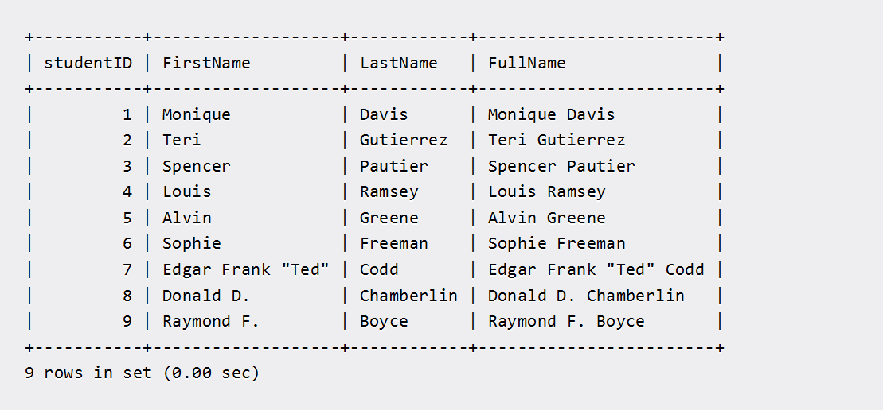
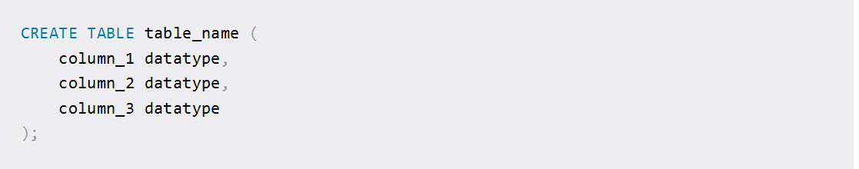
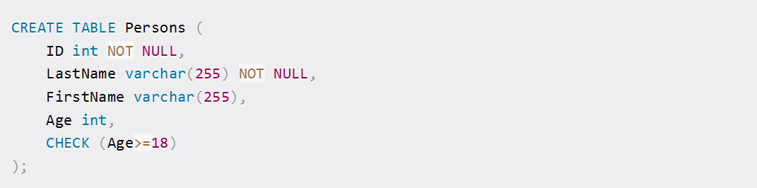
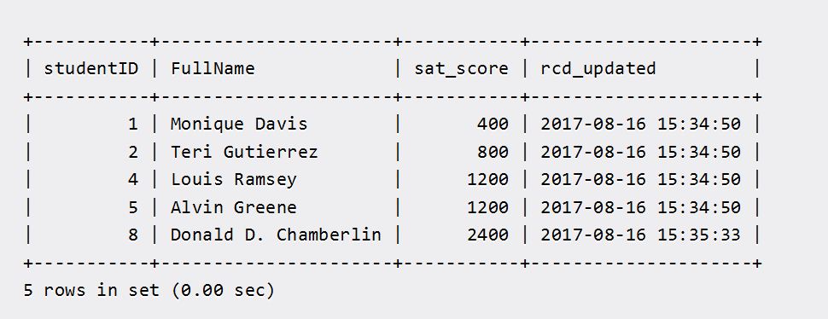
SQL

Slide 7
Zdroje
https://www.freecodecamp.org/news/basic-sql-commands/
https://www.google.com/url?sa=i&url=https%3A%2F%2Fblog.supportgroup.com%2Fgetting-started-with-relational-databases-one-to-one-and-many-to-many-relationships&psig=AOvVaw3grQllQXVJRremz_Il8Pwd&ust=1704912574432000&source=images&cd=vfe&opi=89978449&ved=0CBIQjRxqFwoTCJDtprb80IMDFQAAAAAdAAAAABAD
https://www.google.com/url?sa=i&url=https%3A%2F%2Fhelp.claris.com%2Farchive%2Fhelp%2F18%2Ffmp%2Fen%2FFMP_Help%2Fone-to-one-relationships.html&psig=AOvVaw2uJLjAGl7RThhLdmeGpqQy&ust=1704912557924000&source=images&cd=vfe&opi=89978449&ved=0CBEQjRxqFwoTCIj-2K380IMDFQAAAAAdAAAAABAD
https://www.google.com/url?sa=i&url=https%3A%2F%2Fhelp.claris.com%2Farchive%2Fhelp%2F18%2Ffmp%2Fen%2FFMP_Help%2Fone-to-many-relationships.html&psig=AOvVaw18P1YsCJjo_InA6l7bhU3m&ust=1704912509324000&source=images&cd=vfe&opi=89978449&ved=0CBIQjRxqFwoTCMDNm_D90IMDFQAAAAAdAAAAABAD
https://www.google.com/url?sa=i&url=https%3A%2F%2Fwww.101computing.net%2Frelational-databases%2F&psig=AOvVaw2YxX6KDQhACdpMj4DzFfB-&ust=1704911881658000&source=images&cd=vfe&opi=89978449&ved=0CBIQjRxqFwoTCNiRhu350IMDFQAAAAAdAAAAABAI
https://ki.ujep.cz/opory/Aplikovana_Informatika/Bc/Uvod_do_relacnich_databazi.pdf
https://chat.openai.com/c/78e7f615-31a0-4d67-95b6-c6f0a1f7e597
https://wikisofia.cz/wiki/Rela%C4%8Dn%C3%AD_datab%C3%A1ze
https://www.google.com/imgres?imgurl=https%3A%2F%2Fwww.thoughtco.com%2Fthmb%2F0-Le1GpKJDgVfdBH4LxY_avQ90A%3D%2F1500x0%2Ffilters%3Ano_upscale()%3Amax_bytes(150000)%3Astrip_icc()%2Fkisspng-microsoft-sql-server-windows-server-2008-r2-b47d7cc742ab406d87b638c3ecd3f598.jpg&tbnid=X4EMMp4uIkHu3M&vet=12ahUKEwil2MWW_tCDAxVxgP0HHe9jCvYQMygKegQIARBf..i&imgrefurl=https%3A%2F%2Fwww.thoughtco.com%2Fmicrosoft-sql-server-2008-r2-1019821&docid=ph928Mr-uZiiiM&w=900&h=440&q=microsoft%20sql&client=firefox-b-d&ved=2ahUKEwil2MWW_tCDAxVxgP0HHe9jCvYQMygKegQIARBf
https://www.google.com/imgres?imgurl=https%3A%2F%2Fcdn-images-1.medium.com%2Fmax%2F480%2F0*1wCzQr7YMgEiZAMB.png&tbnid=XLNWXvp7Qe6weM&vet=12ahUKEwjqvfOh_tCDAxVxg_0HHfHjCUsQMygBegQIARBP..i&imgrefurl=https%3A%2F%2Fmedium.com%2Fcodex%2Fwalk-through-on-ibm-db2-schema-97aa428f9f32&docid=Y8S2WCBsx0AzsM&w=300&h=300&q=DB2%20IBM&client=firefox-b-d&ved=2ahUKEwjqvfOh_tCDAxVxg_0HHfHjCUsQMygBegQIARBP
https://www.google.com/imgres?imgurl=https%3A%2F%2Fd1.awsstatic.com%2Fasset-repository%2Fproducts%2Famazon-rds%2F1024px-MySQL.ff87215b43fd7292af172e2a5d9b844217262571.png&tbnid=iNzoFCxK5x6qnM&vet=12ahUKEwj_udaq_tCDAxWpgv0HHTj0BPIQMygDegQIARBY..i&imgrefurl=https%3A%2F%2Faws.amazon.com%2Frds%2Fmysql%2F&docid=abacBKOFA5VUoM&w=1024&h=530&q=my%20sql&client=firefox-b-d&ved=2ahUKEwj_udaq_tCDAxWpgv0HHTj0BPIQMygDegQIARBY

